Slide 1

SAM CONTROLS
SOFTWARE PRODUCT
FOR
AUTOMATION

Slide 2
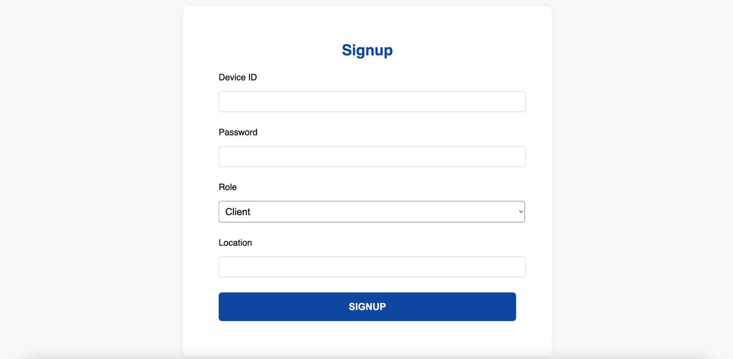
SIGNUP

Slide 3
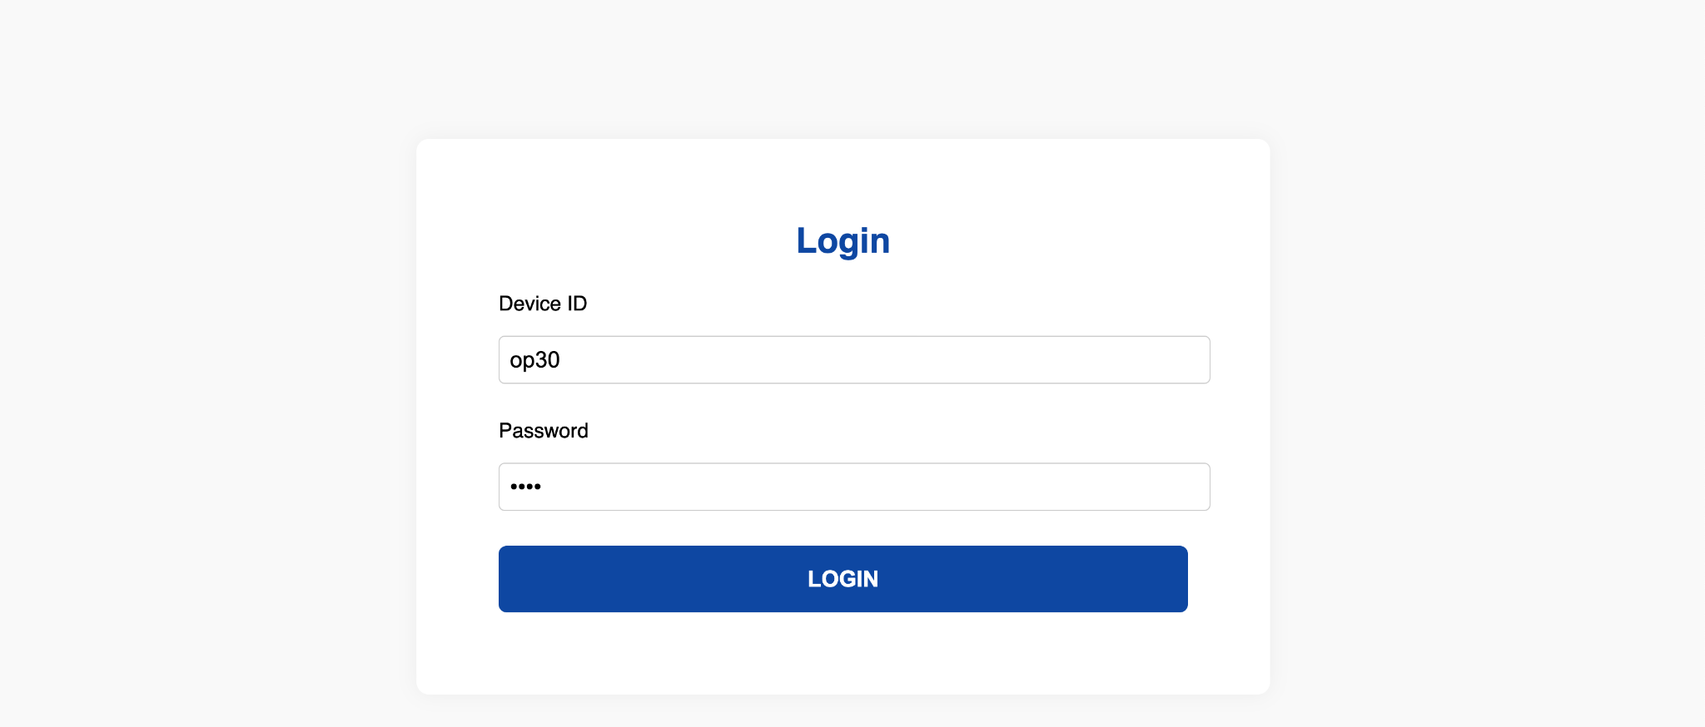
LOGIN

Slide 4
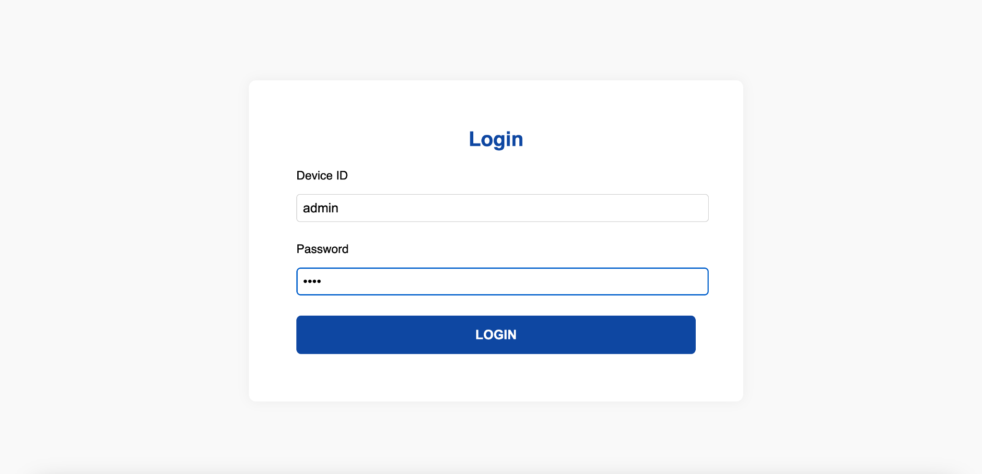
ADMIN LOGIN

Slide 5
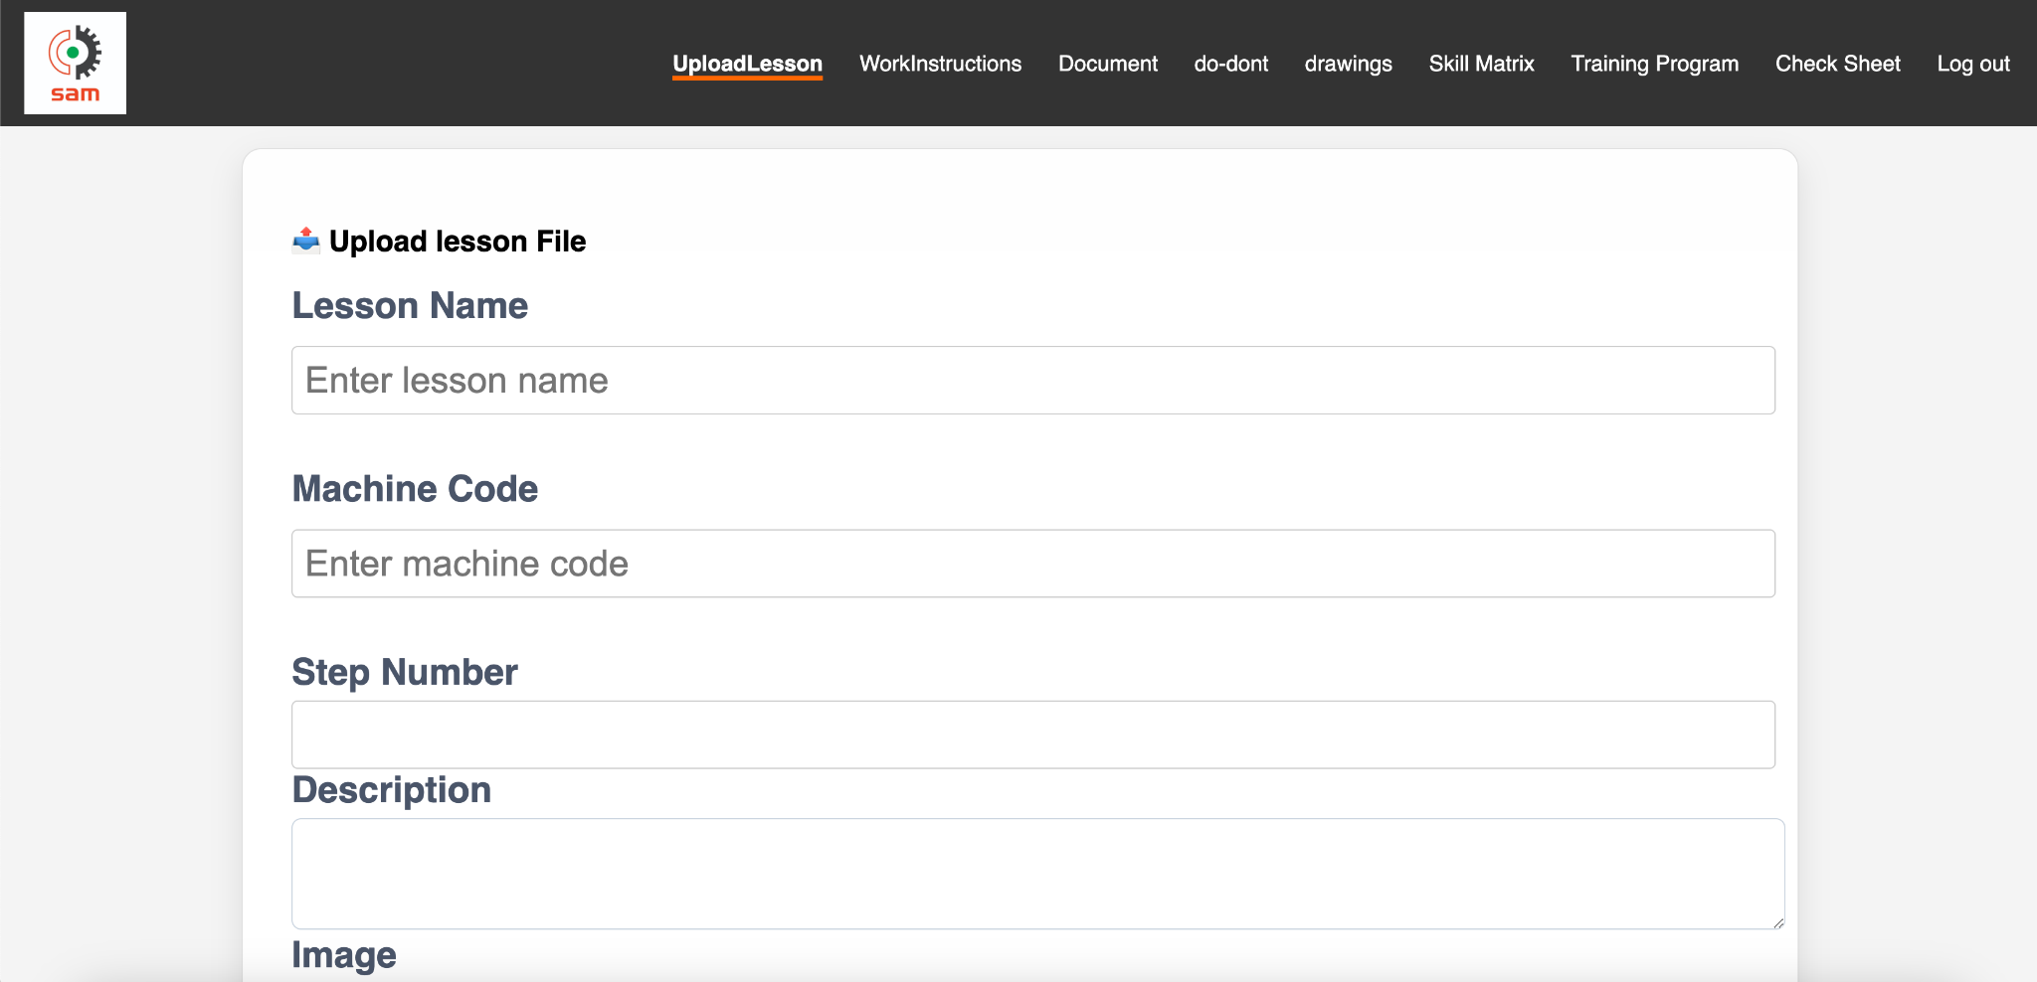
ADMIN FORM AND OPTIONS
OPTIONS

Slide 6
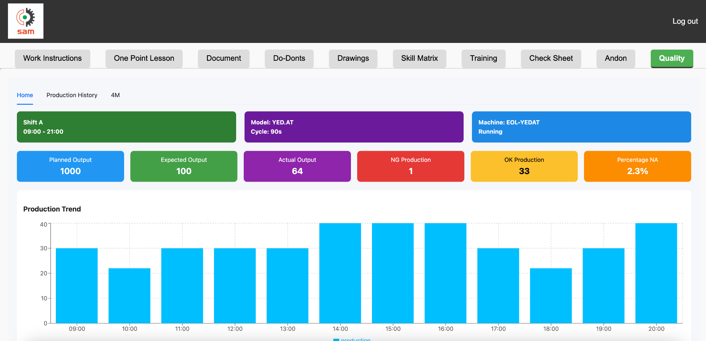
USER SIDE
FUNCTION TABS

